Slide 1
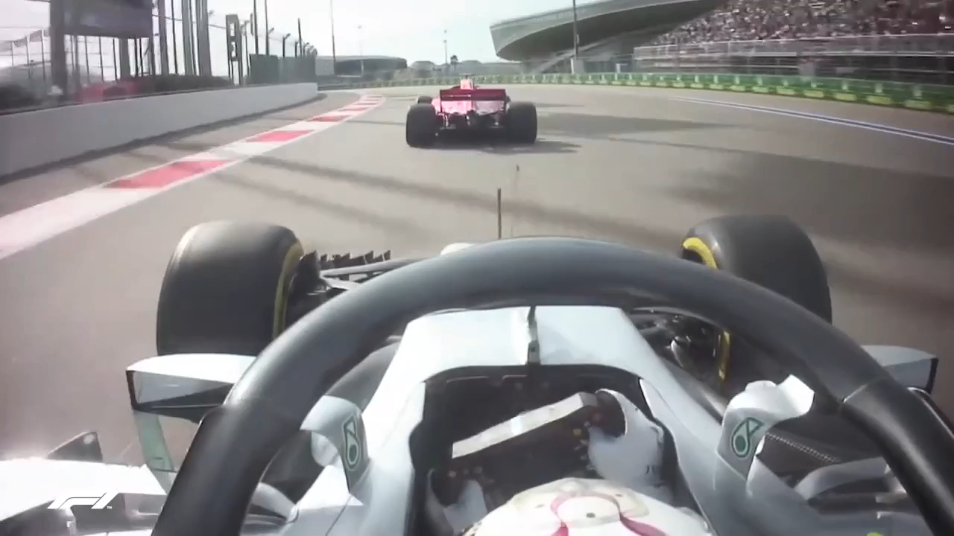

Slide 2



An Application to Optimize Lap-times for Race Cars
Group Members:
Alaa Bashir | ge73cec
Ankit Khot | ge73xuq
Máté Kelemen | ge49pil
Supervised by: Jan Janse van Rensburg and Steve Schäfer

Slide 3
Goals

Slide 4


Problem Statement:

Slide 5
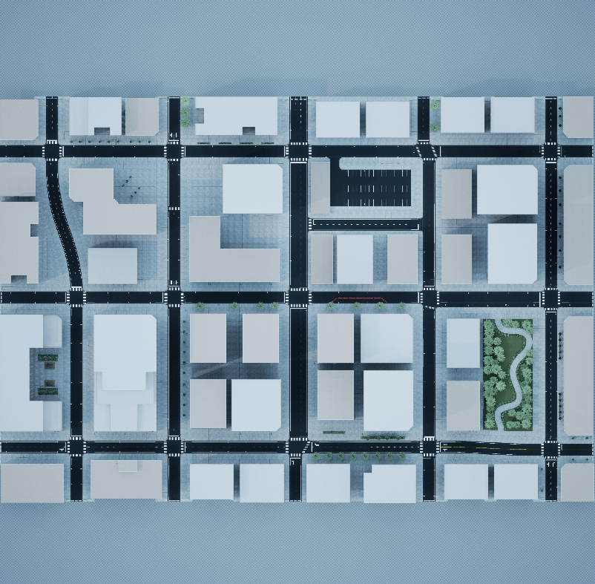
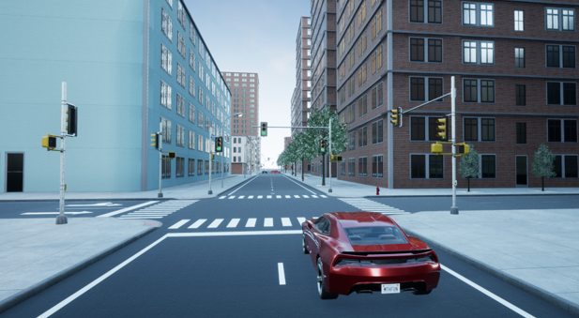

Slide 6


Tasks:
Determine optimal
racing lines and
speeds
Determine circuit geometry from maps
Simulate the results
Choose the
suitable car

Slide 7
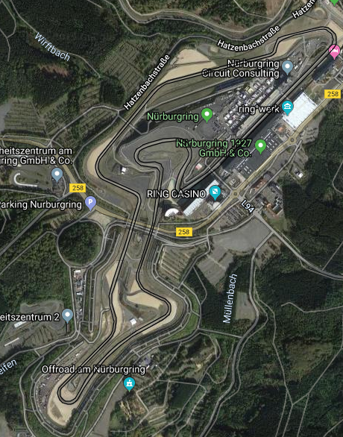
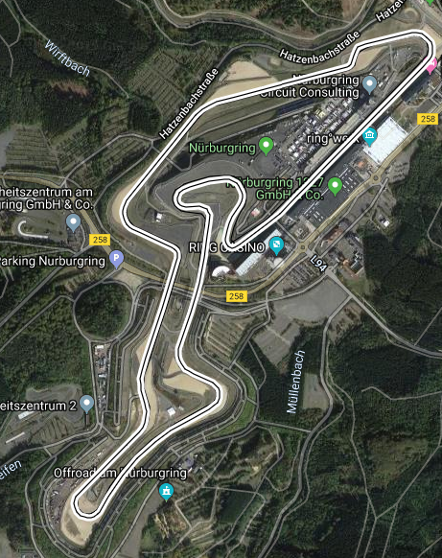
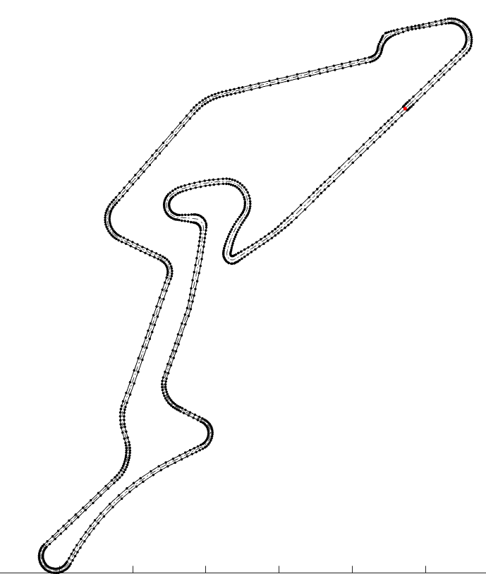
Race Circuit Geometry
Use Google Maps
Obtain the Latitudes and Longitudes from the GPS Exchange format.
Use MATLAB’s Mapping Toolbox to convert the data to x and y co-ordinates.

Slide 8
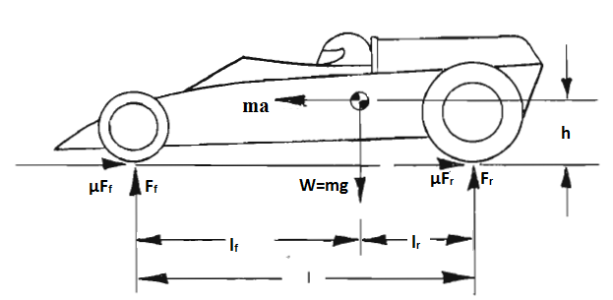
Vehicle Model Data
Curvature – Critical Velocity
Depends on vehicle parameters such as:
Position of center of gravity
Weight distribution on wheels
Coefficient of friction
Track width of the vehicle

Slide 9
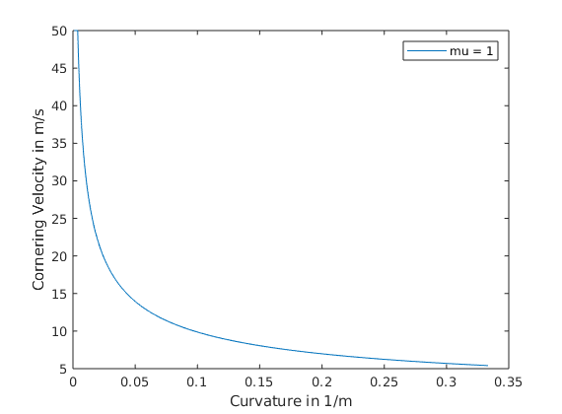
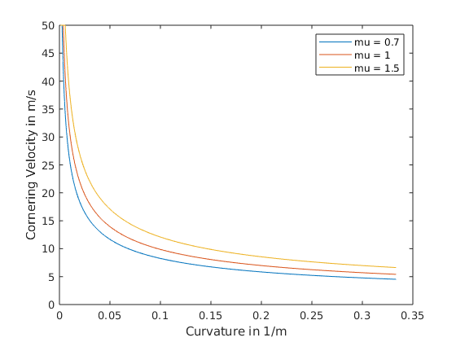
Vehicle Model Data
Curvature – Critical Velocity data

Slide 10
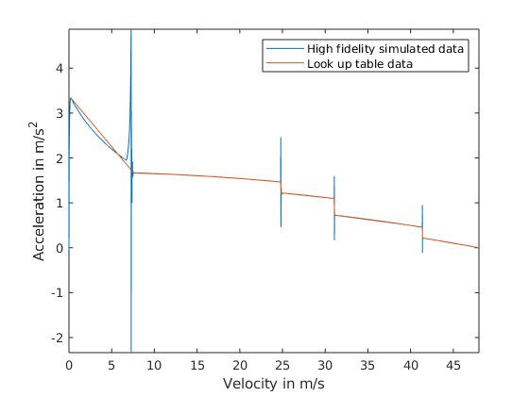
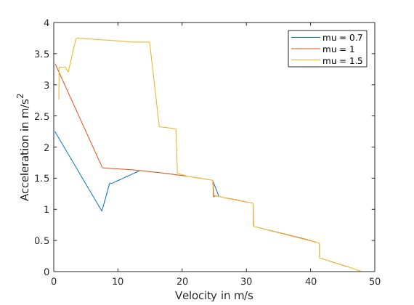
Vehicle Model Data
2. Wide open throttle test
Gear Shift

Slide 11
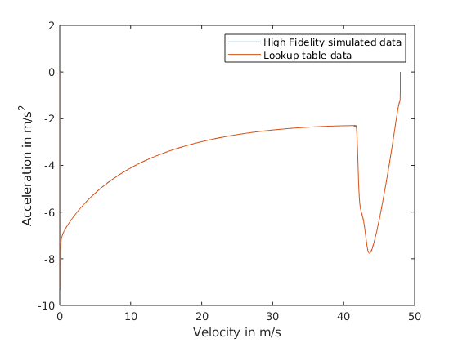
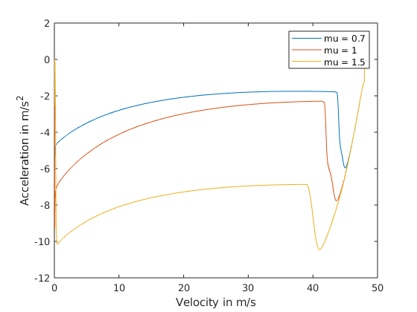
Vehicle Model Data
3. Full Brake test

Slide 12
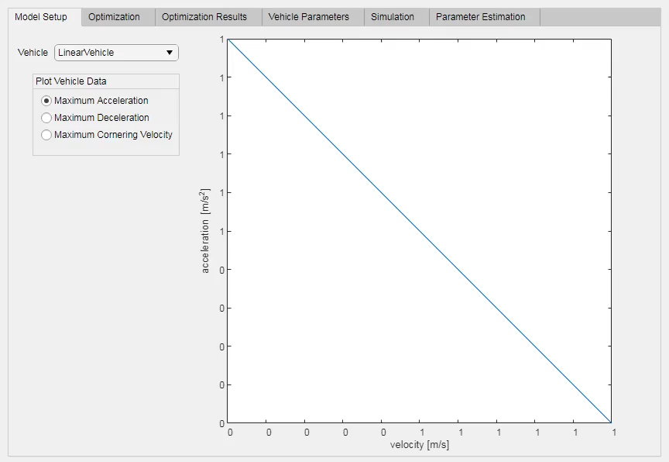
Path Optimization
Set vehicle model
Import track
Discretize
Track discretization
Subsampling
Sectioning

Slide 13
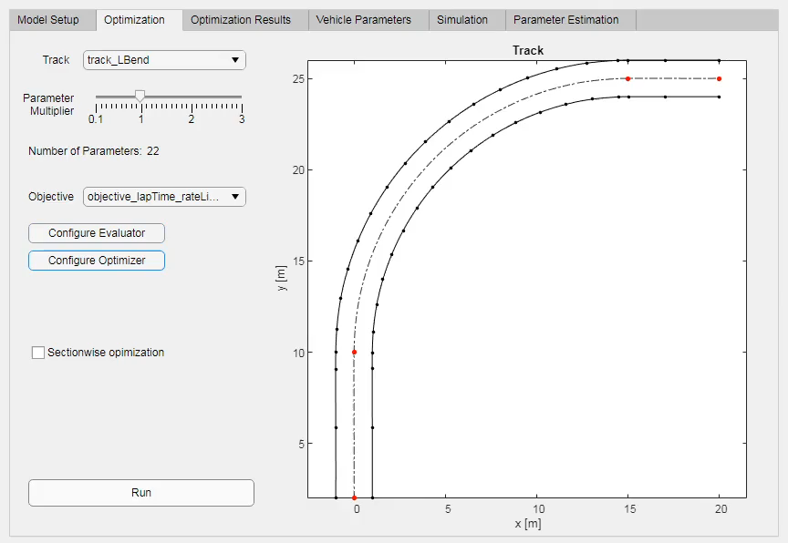
Path Optimization
Set vehicle model
Import track
Discretize
Track discretization
Subsampling
Sectioning
Set optimization options
Run optimization

Slide 14
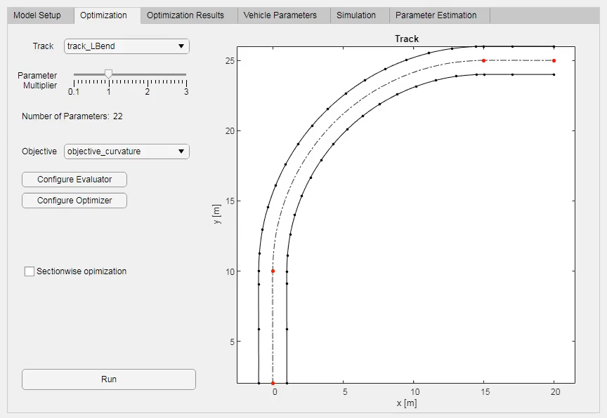
Path Optimization
Set vehicle model
Import track
Discretize
Track discretization
Subsampling
Sectioning
Set optimization options
Run optimization

Slide 15

Integration
Optimization Results:
Optimized path
Velocity profile
Create Driving Scenario
Scenario Object
Create Ref
Path
Simulink Model
Reference Position
Velocity Profile
Curvatures

Slide 16
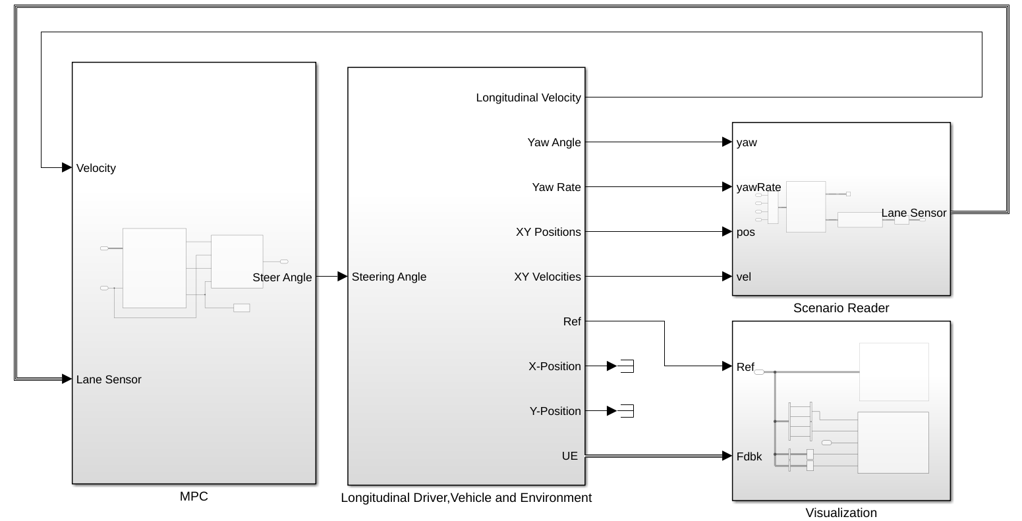
Simulation
Simulink Model Layout
Longitudinal Controller
Lateral Controller
Vehicle Dynamics
Visualization

Slide 17
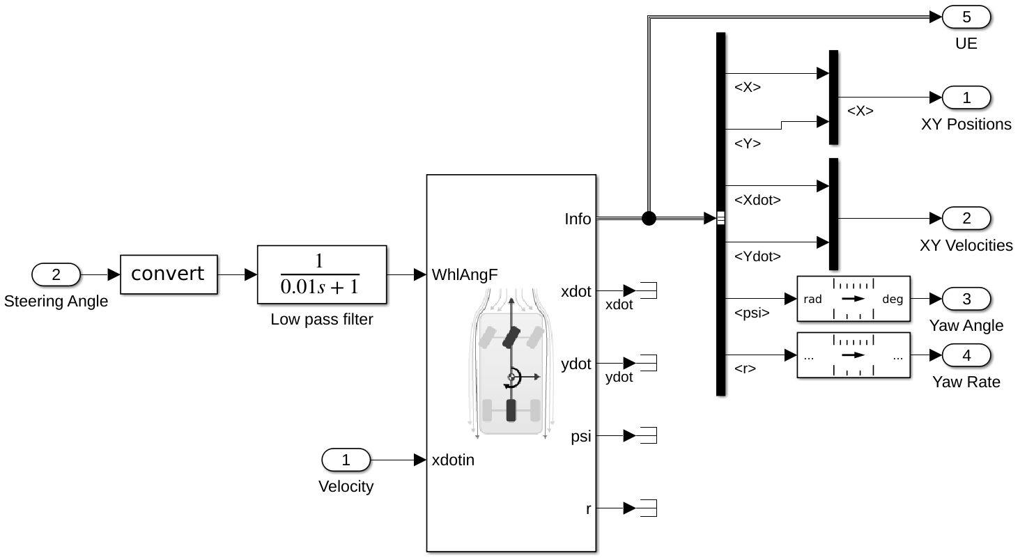
Simulation
Vehicle Dynamics
Feedback
Inputs

Slide 18
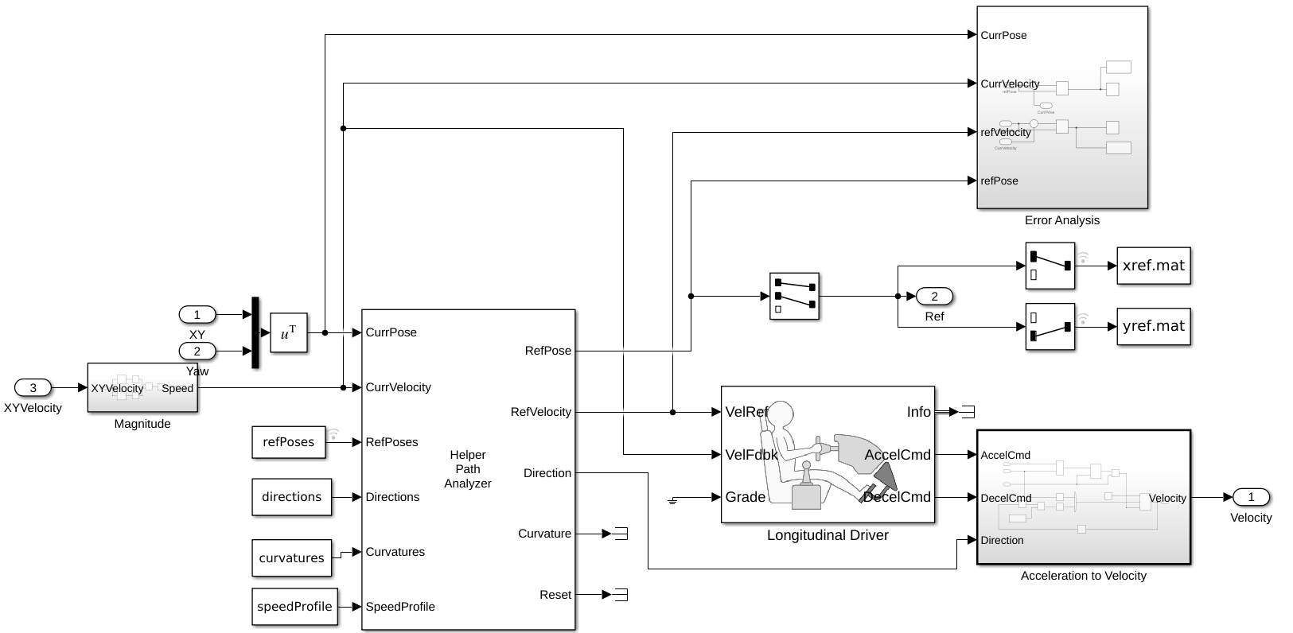
Simulation
Longitudinal Driver
Optimization
Results
Input 1

Slide 19
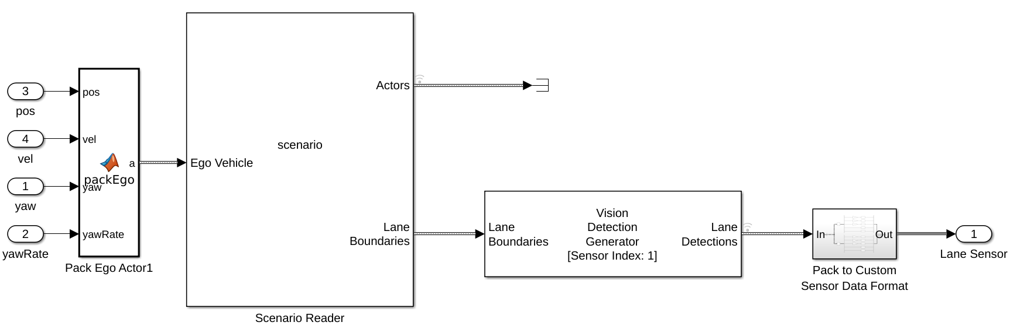
Simulation
Scenario Reader
Optimization
Result

Slide 20
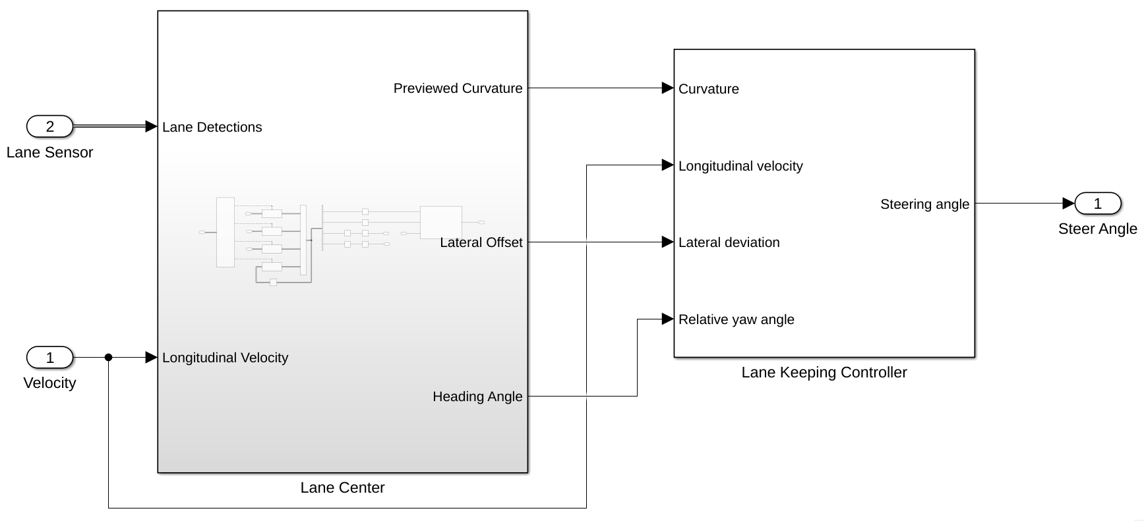
Simulation
Lateral Controller
Lateral Controller
Input 2

Slide 21
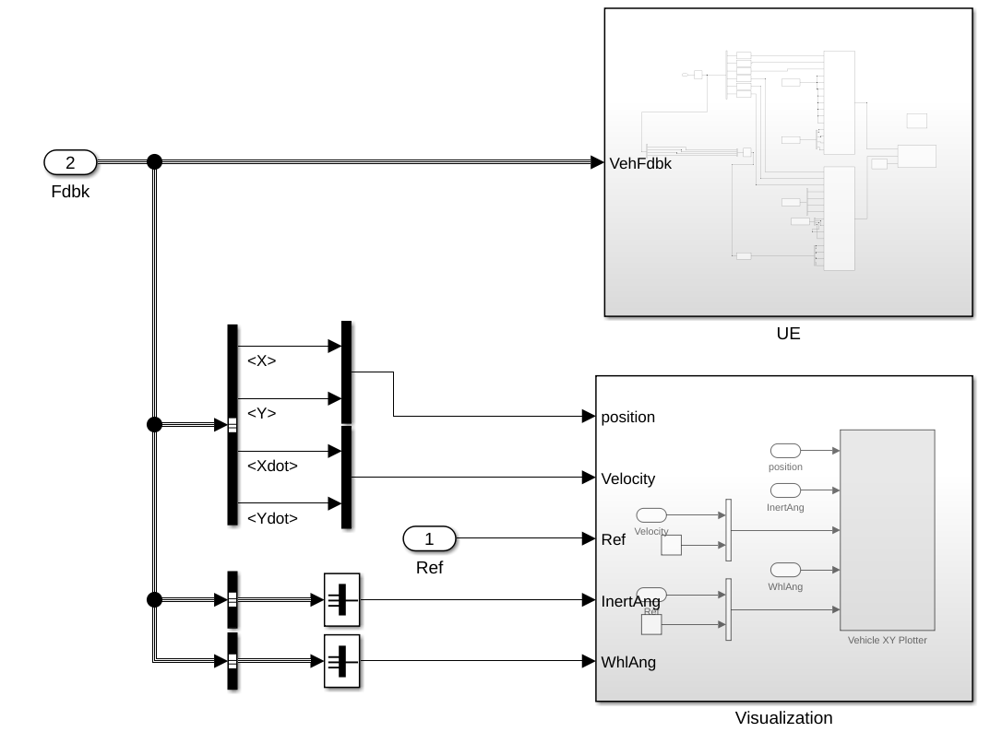
Simulation
Visualization
Feedback
Unreal Engine
XY Plotter

Slide 22
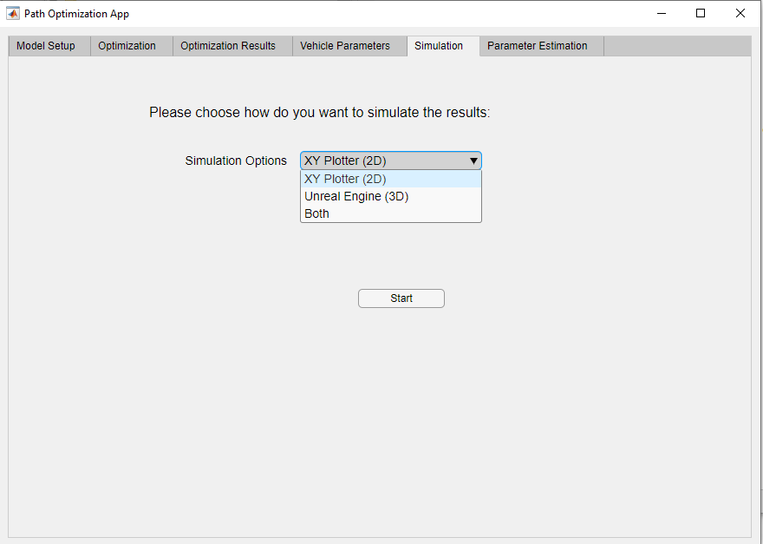

Simulation

Slide 23
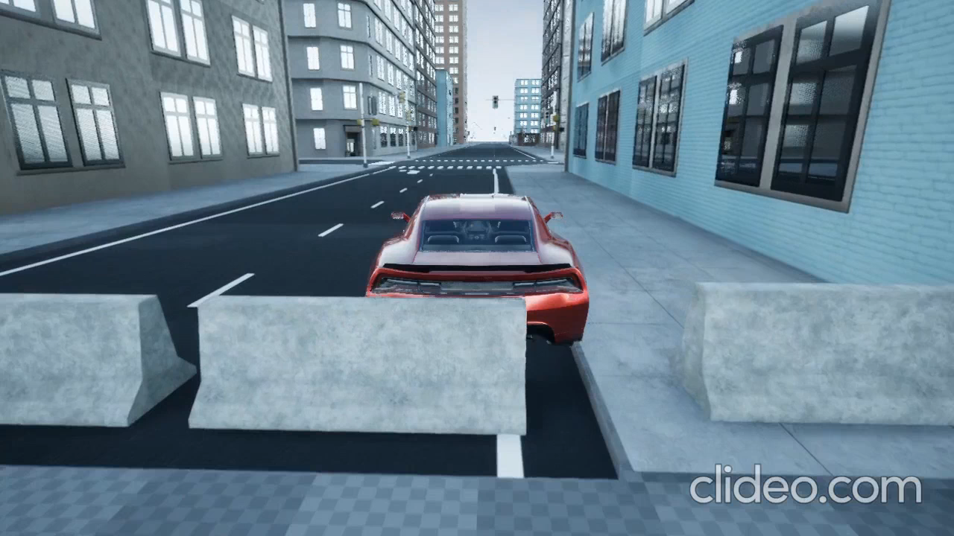
Simulation
Unreal Engine Visualization

Slide 24
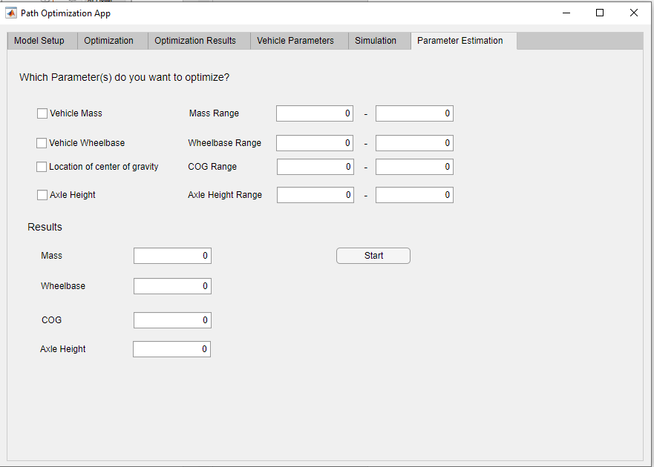

Parameters Estimation

Slide 25
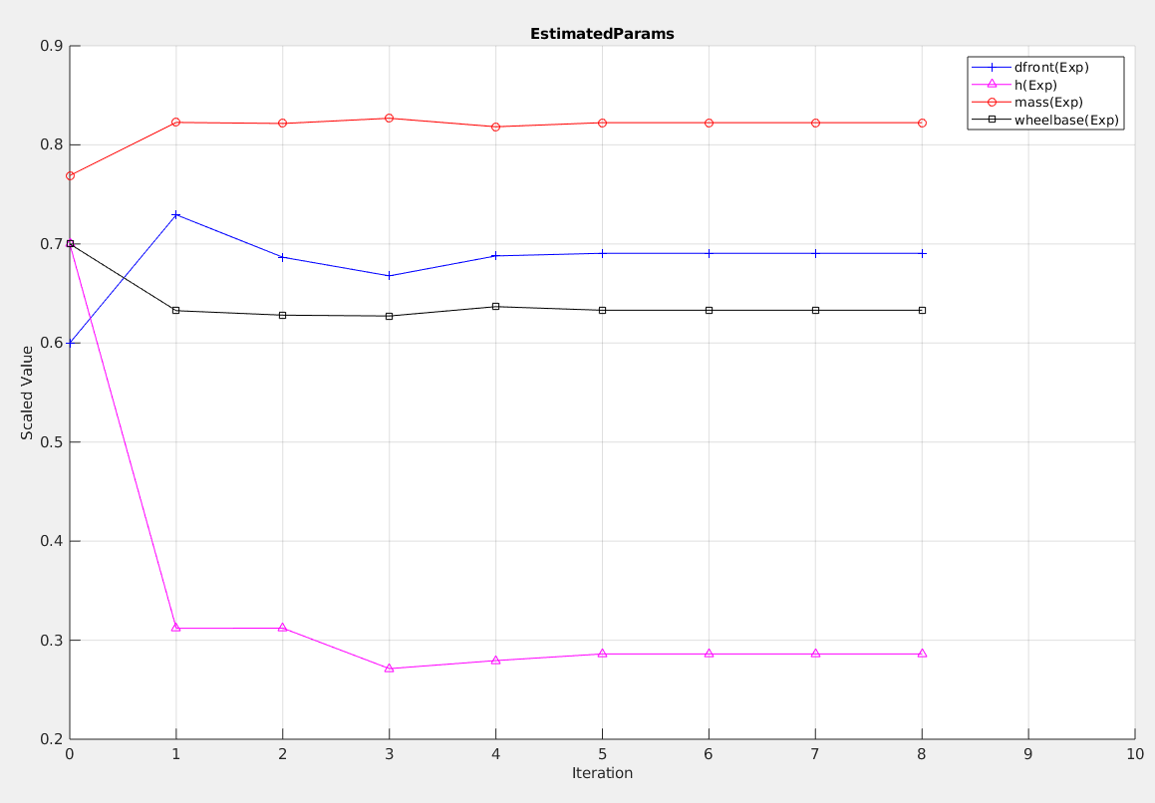
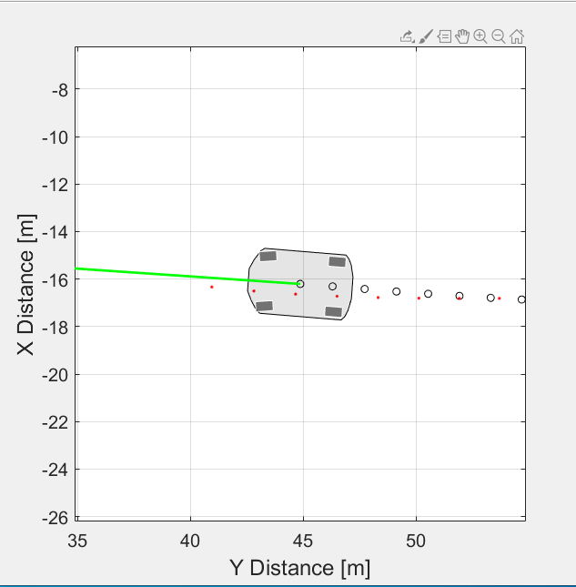
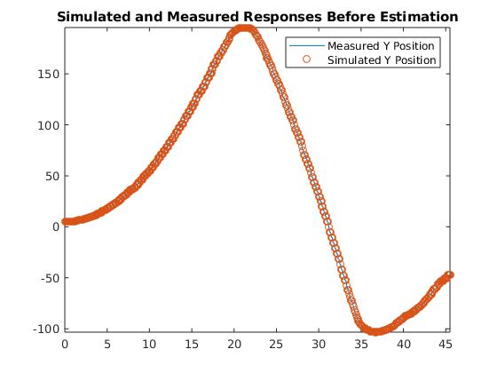
Parameters Estimation
Set parameters
Simulate
Compare

Slide 26


Race Day
Knockout Round:
 | Name | Car Color | Strategy | Lap Time
 | Mean Mark | Red | Center Line
 | Optimum Otto | Blue | Path Optimization App

Slide 27
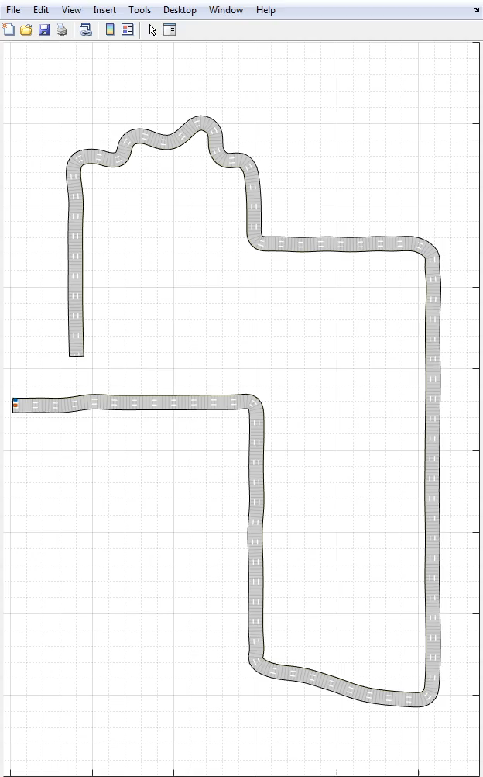
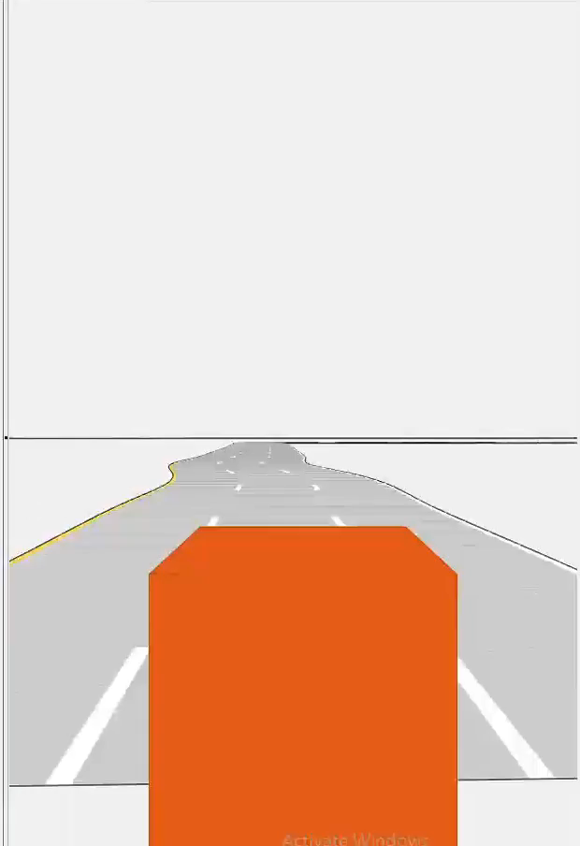
Race Day
Knockout Round:

Slide 28

Race Day
Knockout Round:
 | Name | Car Color | Strategy | Lap Time
 | Mean Mark | Red | Center Line | 87.8
 | Optimum Oli | Blue | Path Optimization App | 79.3

Slide 29

Summary
Literature Review
Implement different vehicle models
Determine circuit geometry from images
Find the optimum path and velocity profile
Compare the results with high fidelity model
Visualize the results with Unreal Engine

Slide 30
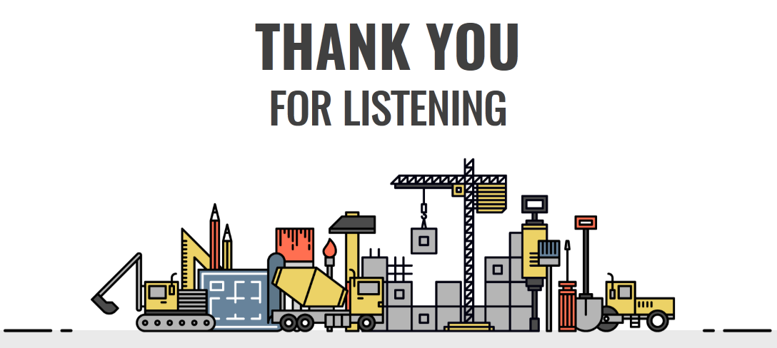
Stay on the right path!

